Slide 1
LLM-Driven SystemVerilog Assertion
Generation for Formal Verification
CS525 – Formal Methods for System Verification
Group 2
Pranjal 230101077
Dhruvkumar R Pansuriya 230101071
Shrish Uttarwar 230101108
IIT Guwahati · Dept. of Computer Science & Engineering · April 2026

Slide 2

Problem Statement
Primary Research Question:
How can an automated system synthesise information from ambiguous, multi-page natural-language specifications and complex RTL code to generate SVAs that are both syntactically correct and functionally meaningful — within the token and cost constraints of modern LLMs?

Slide 3
Problem Statements & Task Objectives
P1. Long-Context Limits — selecting a minimal, sufficient context subset.
P2. Agent Memory — accumulating and reusing verified knowledge across steps.
P3. Cloud Communication Efficiency — reducing API token and latency overhead.
P4. Redundancy in Multi-Agent Systems — minimizing duplicated computation and assertions.
P5. Feedback-Driven Refinement — improving outputs using verifier or critic feedback.

Slide 4
Our Solution
▶
“Turning ambiguous specs + complex RTL into precise assertions using LLMs + structured reasoning.”
▶
“Efficient, scalable, and feedback-driven—built to handle long context, redundancy, and real-world constraints.”

Slide 5
Knowledge Graph (KG)
Stage 1: Extraction
Spec PDF
RTL Code
Stage 2: Signal Mapping
& Graph Construction
Graph RAG
KG Construction
PyVerilog
RTL Parser
LLM Signal Mapping & Alias Table
Unified Knowledge Graph

Slide 6
Unified Context Retrieval (SSR+GRW)
LLM Lingua (Compression)
Shared GPTCache (Semantic Cache)
Agent
NL Test Plan
Agent
SVA Generation

Slide 7


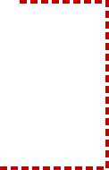
Agent C
NL Test Plan
Agent D
SVA Synthesis
Fail
(Syntax)
Phase 1:
Semantic Alias
Valid IDs
Phase 2:
Verible Syntax
Semantic Alias: Matches generated signal names with valid RTL identifiers to detect hallucinated or incorrect signals.
Verible Syntax: Checks whether the generated SVA follows correct SystemVerilog syntax and reports syntax errors.

Slide 8
System Architecture — Full Pipeline
Stage 1
Stage 2
Stage 3
Stage 4
Extraction &
Alignment
Context Synthesis
& Compression
SVA Generation
Checking
& Repair
Spec PDF +
RTL Verilog
Global
Summarisation
Agent C
NL Test Plan
Phase 1
Alias Validation
▶
▶
▶
GraphRAG KG
(Spec-side)
Signal-Specific
Retrieval (SSR)
Agent D
SVA Synthesis
Phase 2
Verible Syntax
PyVerilog
(RTL-side)
LLMLingua
Compression
Groq API
(Fast Format)
LLM Repair
Loop
Signal Mapping
& Alias Table
GPTCache
Routing
Cache
Deduplication
Accepted SVAs
.sva files
Unified KG
G = (V, E)
Diagnostics
JSON Reports

Slide 9
Stage 1 — Knowledge Graph Construction
Spec-Side: GraphRAG + Domain Schema
RTL-Side: PyVerilog Parser
Entity Types (Et):
Module structure — AST traversal;
ports (direction, width);
module instantiations
Module · Signal · Port · Register · FIFO · Clock · Interrupt · FSM · Protocol · Constraint
KG refinement — RTL info merged into G₀ to enrich spec-side graph
Relation Types (Rt):
connectsTo · defines · triggers · dependsOn · HasSignal · UsesClock · DescribesOperation · transmitsData · corresponds_to
Spec KG + RTL KG → Unified Knowledge Graph G = (V, E)
Spec KG + RTL KG → Unified Knowledge Graph G = (V, E)

Slide 10
Signal Mapping — Bridging Spec & RTL
"system reset" in spec ↔ nRST / rst_n in RTL — without alignment, generated SVAs reference non-existent signals
1
Input Extraction
Spec entities from KG node types (SIGNAL, PORT, REGISTER, CLOCK)
RTL module ports & internal signals from PyVerilog
Key Artifacts
▸ signal_aliases.json
2
LLM Semantic Alignment
LLM receives mentions + RTL signals + local spec context
Outputs JSON: canonical_name · rtl_name · confidence · active_low · match_method
▸ alias_lookup_table.json
▸ signal_mapping_decisions.json
3
Alias Table Construction
▸ alignment_full_prompt.txt
Fast lookup: RTL signal → canonical name
Normalises naming variants; basis for fuzzy fallback matching
▸ signal_mapping_overview.json
4
Confidence Gating (≥ 0.7)
HIGH: inject corresponds_to edges into Unified KG
LOW: string-based substring similarity → references edges

Slide 11
Stage 3 — SVA Generation
Two-Step Generation via Groq
Natural Language Test Plan
LLM generates human-readable verification intents from pruned context
Step 1
e.g. "Verify that TX_EMPTY asserts when the FIFO count reaches zero"
→ nl_plans.txt
SVA Synthesis
Each NL plan → formal SystemVerilog Assertion
Prompt includes correct SVA syntax examples as few-shot guidance
Step 2
e.g. @(posedge PCLK) ((PADDR >= 24) && (PADDR <= 31)) && (PENABLE) |-> ((PADDR >= 0) ...
→ property_goldmine_N.sva

Slide 12
KG as Robust Agent Memory (P2)
Traditional RAG fails when causal hardware logic is fragmented across semantic chunks.
Memory Representation & Fidelity
RQ1.4
Structured entity-relation schemas (E_t, R_t) outperform flat embeddings.
KG enforces relational memory — updates are edge insertions/attribute changes, not vector dilution.
Causal links (clock-domain crossings, nested resets) preserved reliably.
Task-Adaptive Memory Granularity
RQ1.6
Broad Test Planning (Agent C): coarse-grained SSR at 800+ token chunks.
Precise SVA Synthesis (Agent D): GRW-AS extracts exact causal chains (TX_EMPTY → apb → PRESETn).
LLMLingua applies high compression to verbose spec memory, keeps RTL memory intact.
Memory structure: Spec Vectors (semantic) + RTL AST (structural) → fused inside Unified KG

Slide 13
LLMLingua — Prompt Compression (P1 + P3)
Coarse-to-fine prompt compression: small LM computes token perplexity → prunes low-information tokens → compressed prompt to GPT-4o / Groq.
Overall Statistics
Tokens w/o LLMLingua: 4616
Tokens w/ LLMLingua: 3876
Total Reduction: 16.03%
Detailed Breakdown
Dynamic NL Generation
Origin: 2163 | Compressed: 1807
Dynamic SVA Generation
Origin: 2453 | Compressed: 2069

Slide 14
Multiagent Orchestration with GPTCache (P3 + P4)
Eliminates redundant cloud API calls by storing and retrieving semantically similar prompt responses.
Query
+Prompt
Embedding
Generator
Similarity
Evaluator
Cache
Hit?
Return Cached
Response (0ms)
→
→
→
YES →
NO ↓
Call
Cloud LLM
→ Store → Return
Problems Addressed:
RQ1.7 — Minimizes information transfer; cached responses bypass full prompt re-transmission
RQ2.2 — Early redundancy detection; intercepts repeated queries before reaching LLM
RQ2.4 — Prompt mapping via embedding-based similarity; reuses results above threshold
RQ2.5 — Flexible caching granularity: prompt-level or chunk-level
Cache key = hash(agent_id + prompt_version + exact context) → prevents cross-agent contamination

Slide 15
Multiagent Orchestration with GPTCache (P3 + P4)
Task decomposition + specialisation to improve assertion quality while maintaining cloud efficiency.
Agent A
Agent B
Agent C
Agent D
Agent E
Spec
Understanding
RTL
Grounding
Test
Planner
SVA
Synthesizer
Referee /
Checker
→Gemini
→Gemini
→Groq
→Groq
→Gemini

Slide 16
Two-Phase Assertion Quality Gate
Semantic Alias Validation
[ Phase 1 ]
Phase 1
(Loop A)
Extract candidate identifiers from SVA
Compare with valid alias lookup table
One repair attempt if invalid signals detected
Why default-off: strict pre-filter over-rejects on noisy/generated corpora
Verible Syntax Check
Phase 2
(Loop B)
[ Phase 2 ]
Wrap assertion in minimal valid SV module using RTL signals
Run verible-verilog-syntax binary
One repair attempt on failure
Outputs: accepted/ · discarded/ · reports/summary.json · reports/detailed_results.json · reports/logs/

Slide 17
Verible Syntax Validation & Repair (P5)
Feedback-driven refinement loop using Verible — SystemVerilog-aware syntax checker.
Feedback Signals (RQ3.1):
Binary: SVA passes / fails syntax check (#SynC)
Structured: Verible stderr — precise diagnostics (e.g., missing clocking event, invalid operator)
Localized: Line-level error → identifies exact failing assertion fragment
Repair Loop (RQ3.2):
Generate SVA
from LLM
→
Wrap in minimal
SV module
→
Run Verible
syntax check
→
Errors?
Extract snippet
→
Build repair
prompt
→
Re-invoke LLM
→ corrected SVA
Safeguards (RQ3.3):
Local correction per-instance · Bounded repair iterations · Context preserved across iterations · Syntax decoupled from semantic generation

Slide 18
Results

Slide 19
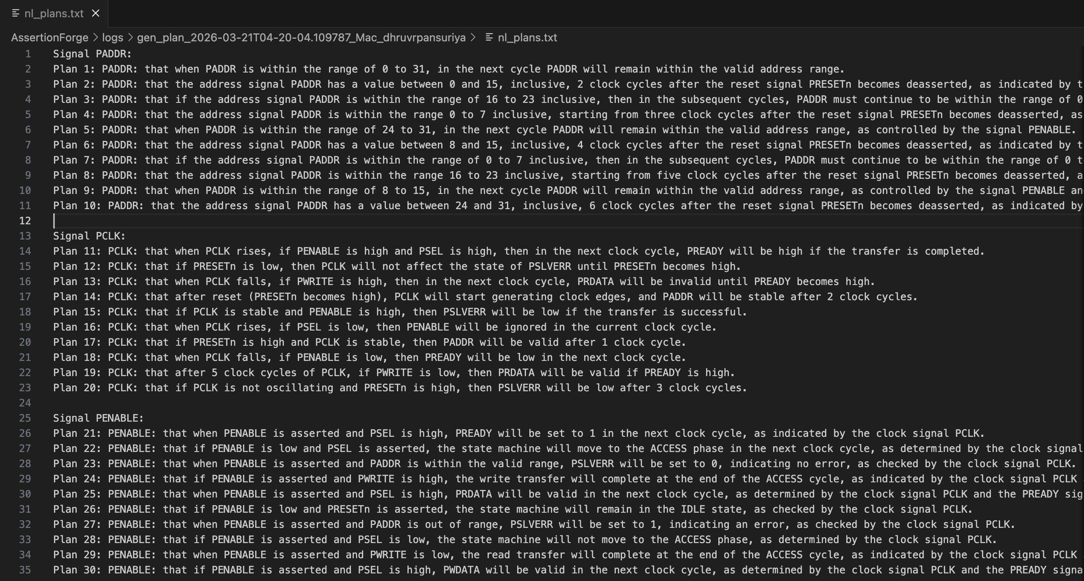
Generated Test Plans

Slide 20
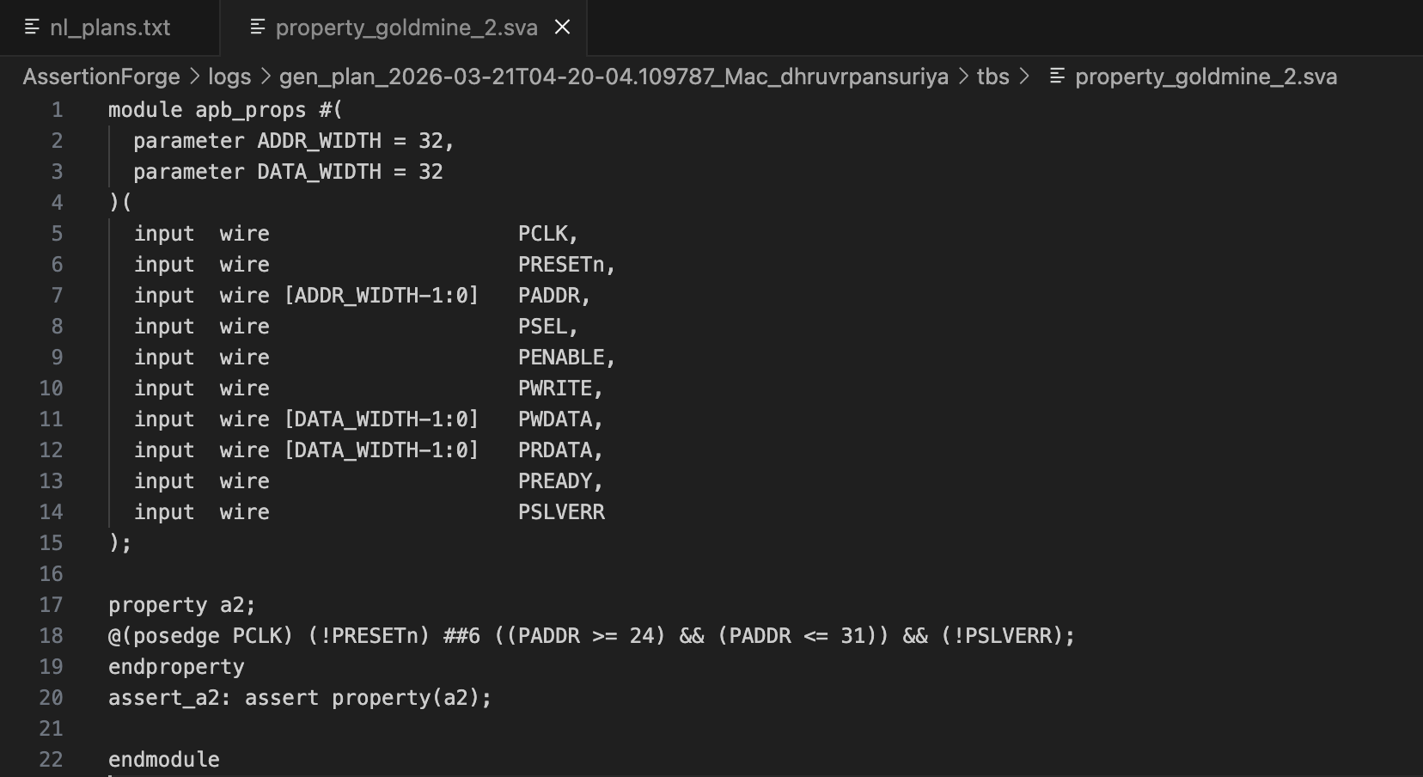
Generated SVAs

Slide 21
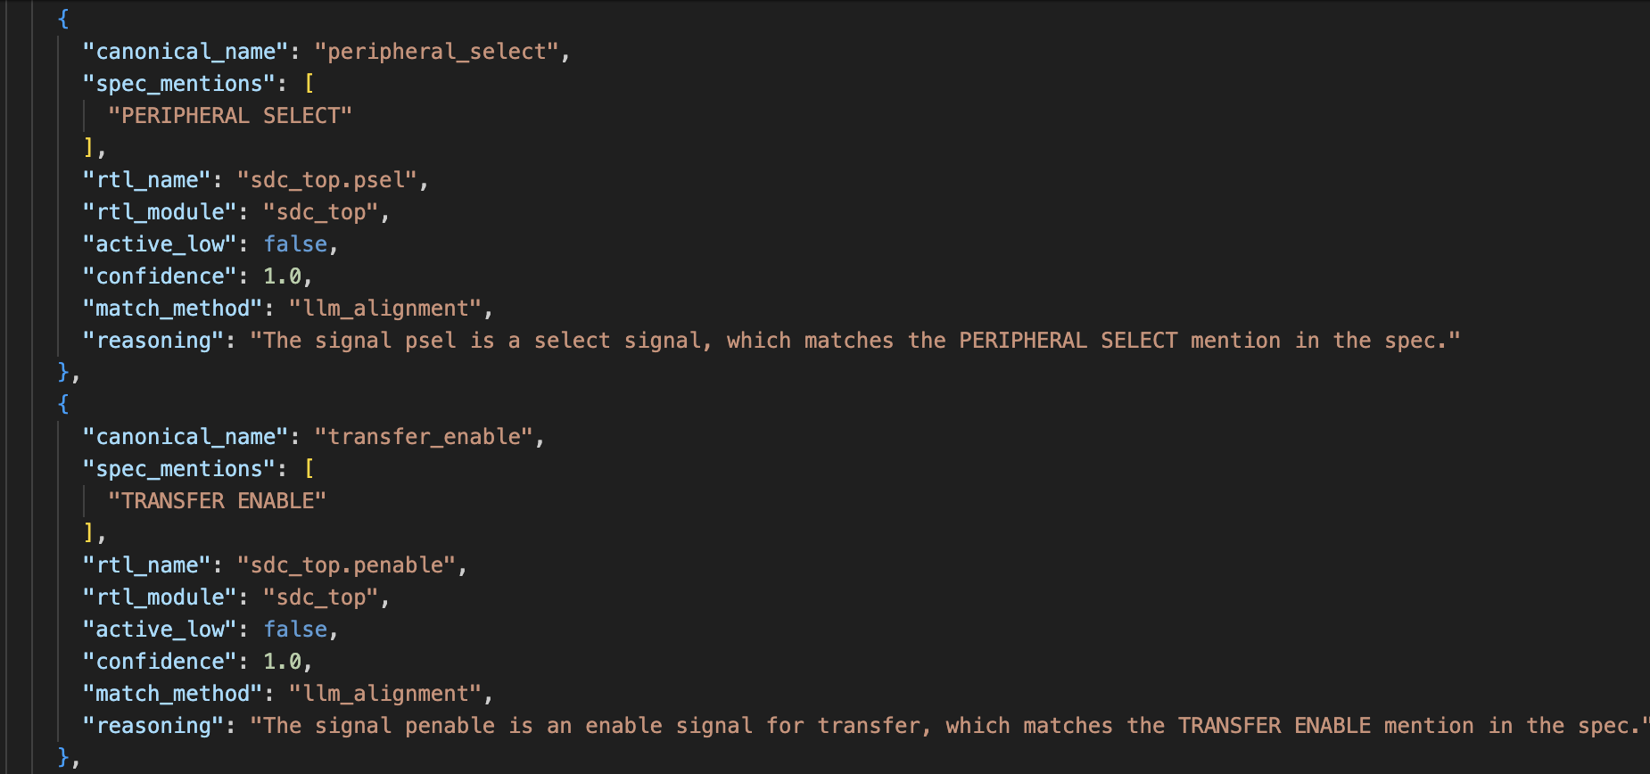
Signal Mapping Output

Slide 22
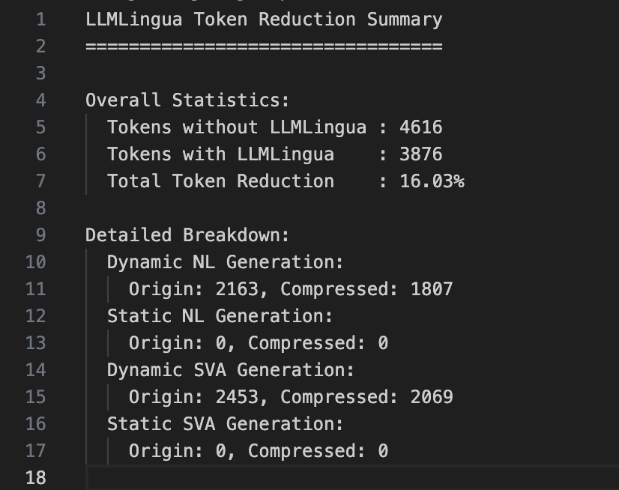
LLMLingua Token Reduction Summary

Slide 23
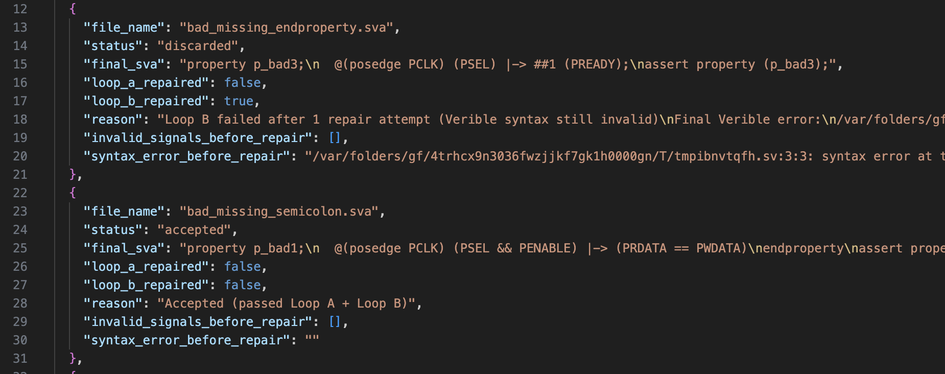
Verible Syntax Checking Results

Slide 24
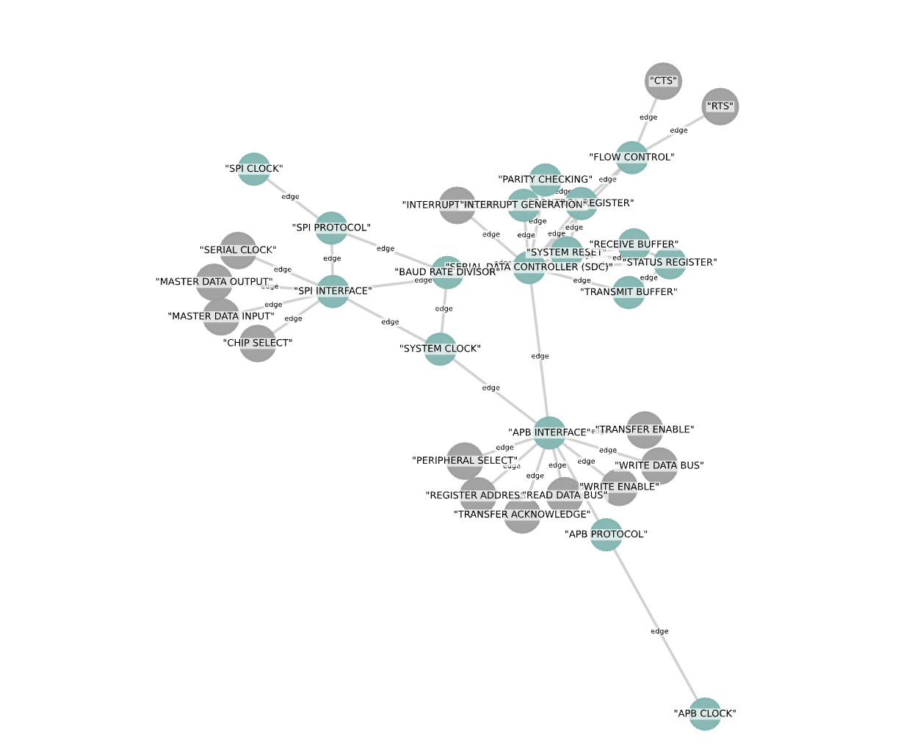
Visualizing Knowledge Graph

Slide 25
Addressing Core Challenges — P1 to P5 Summary
Long-Context Limits
P1
KG node-to-node linking reduces irrelevant chunks · SSR multi-resolution retrieval · LLMLingua minimal context selection (RQ1.1)
P2
Agent Memory
Unified KG as persistent cross-domain memory · structured relational schema vs flat embeddings (RQ1.4, RQ1.6)
P3
Cloud Communication Efficiency
LLMLingua: 16% token reduction · GPTCache eliminates redundant API calls · Groq for fast-turnaround agents (RQ1.7, RQ1.8)
Redundancy in Multi-Agent Systems
P4
GPTCache: early redundancy detection across agents (RQ2.2)
Feedback-Driven Refinement
P5
Verible closed-loop repair: binary + structured + localised error signals · bounded iterations · context preserved · syntax decoupled from semantics (RQ3.1–3.3)

Slide 26
Conclusion & Future Work
Real LLM Repair Integration
Implement repair_sva_with_llm() with schema-constrained JSON output for systematic, parseable fix generation.
Semantic & Formal Validation Stage
Add post-syntax validation: property equivalence checks, formal model-checking hooks (JasperGold), functional correctness beyond Verible.
Robust Signal Edge Materialization
Improve mention-matching robustness (fuzzy + semantic + edit-distance) for reliable corresponds_to edge creation even with naming noise.
Benchmark Suite
Quantitative evaluation: cost/latency/acceptance with vs without cache & multiagent; SVA correctness (#SynC, #SemC) across real-world hardware designs.

Slide 27
Thank you

